Slide 1
NHD 2022 Teacher’s Workshop
PRIMARY & SECONDARY SOURCES
HIGHLIGHTING OBJECTS IN THE RIHS COLLECTION REGARDING THE DORR REBELLION
Contact: reference@rihs.org or 401-273-8107 ext. 410

Slide 2
The Rhode Island Historical Society
Established in 1822, making it the 4th oldest historical society in the United States and will be celebrating our 200th birthday next year!
Largest genealogical research collection in Rhode Island
Our collections include books, manuscripts, graphics, & museum objects.
A member-supported, private institution, we are open to the public and free for members, R.I. Residents, and students

Slide 3
How We Can Help Support Student Projects
We can provide secondary sources that give an overview of a topic
We can provide the required primary sources
Our collections are relevant RI specific topics, but we can also offer RI perspectives of national events
Notes:
We are not professional historians, but we are really good at finding information within our collections

Slide 4
How We Gather Context
Could you tell me what you're working on?
Usually provided, though for best results more background information is necessary (See below)
What is it you want to know about __________? Or What would you like to know about this topic?
What have you already found? Or Where have you already looked for information? Or What do you already know about __________? Or Where have you checked for information so far?
These are important, because we don’t want to send them information they already have
What kind of information on __________ are you looking for?
For us, this will often mean Primary vs. secondary,
If primary, is it images? Diaries? Letters?
Is there something specific about __________ that you are looking for?
For example, if the topic is a person, does the student want to know more about their family life, their professional life, or something else? Or if the topic is an organization, do they have a time period in mind? A specific incident?
What do you mean by __________?
If a word has more than meaning we don’t want to provide the wrong information (in public libraries, for instance, does someone mean Whales as in mammals or Wales the country?)
The “Reference Interview”
Notes:
Some of our researchers know exactly what they want, and have an exact call number and other identifying information and just need my assistance in accessing it (in person, via scans etc.). However, we also get a lot of inquiries that give a really broad or vague topic. Part of our job is to conduct what’s called a reference interview. This is when we gather context about their informational need, so we can provide the material that will best answer their questions.
When someone emails, this means that this process may take time. With some back and forth correspondence happening. I know that students don’t always give themselves that time when it comes to school assignments. (I mean, I had good grades in school and I definitely didn’t). The middle school questions we got last year just asked, “My topic is ____, what do you have”
I tried to ask for more what about the topic they were writing about, but never got any responses. So I have no idea if the information I gathered for them was at all helpful. Because we all want students to get have the best interactions and have everything they need for these projects if this is something you can do with your students prior to having them contact us.

Slide 5
Primary Sources
PRIMARY SOURCES PROVIDE A FIRST-HAND ACCOUNT OF AN EVENT OR TIME PERIOD AND ARE CONSIDERED TO BE AUTHORITATIVE. THEY REPRESENT ORIGINAL THINKING, REPORTS ON DISCOVERIES OR EVENTS, OR THEY CAN SHARE NEW INFORMATION. OFTEN THESE SOURCES ARE CREATED AT THE TIME THE EVENTS OCCURRED BUT THEY CAN ALSO INCLUDE SOURCES THAT ARE CREATED LATER.

Slide 6
The Dorr Rebellion
1842

Slide 7
Before…

Slide 8
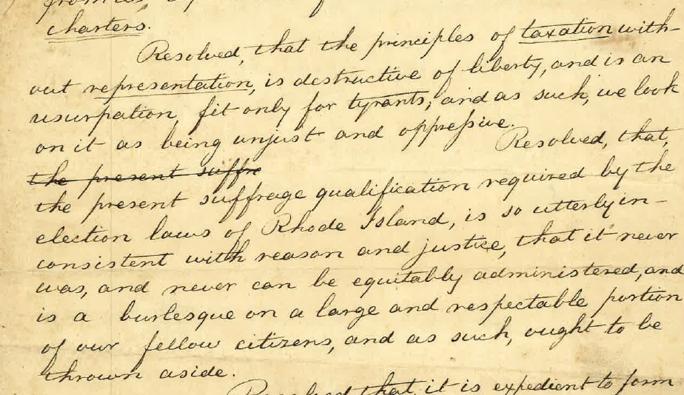
MSS 9001-R RI Suffrage Association, Minutes 1840

Slide 9
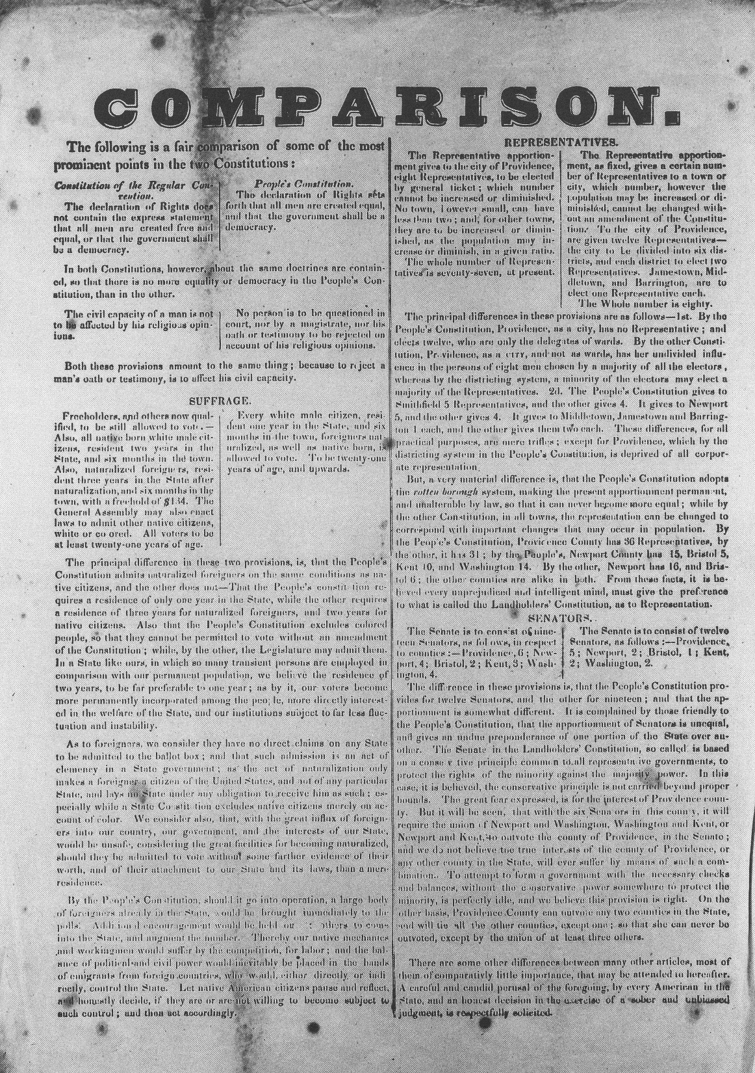
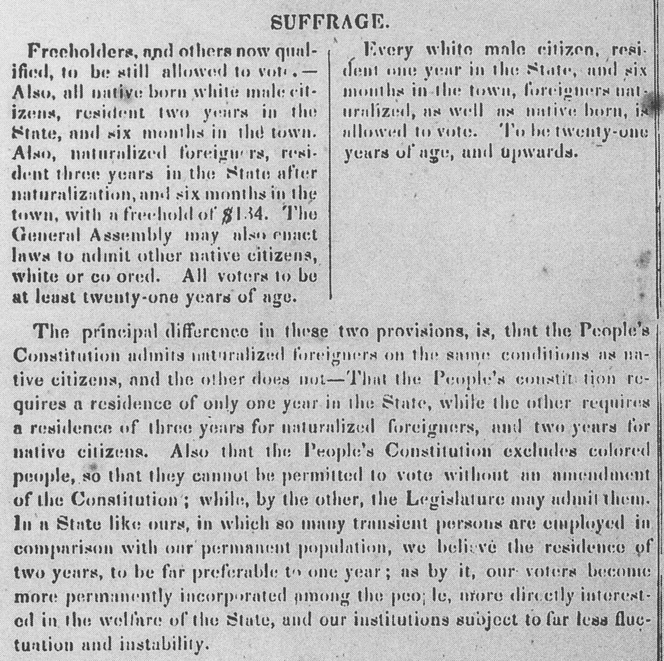

Slide 10
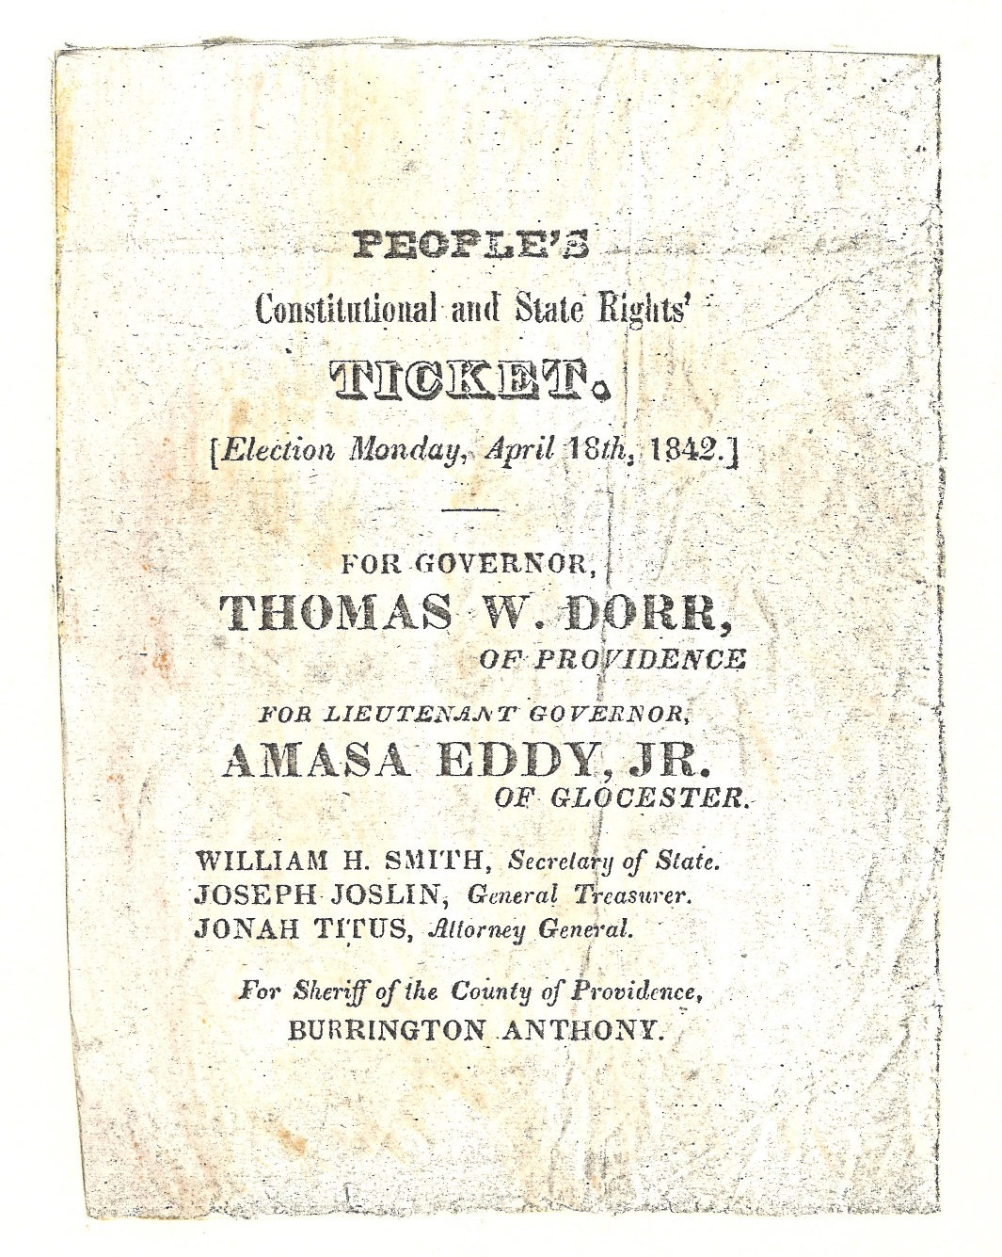

Slide 11
During…

Slide 12
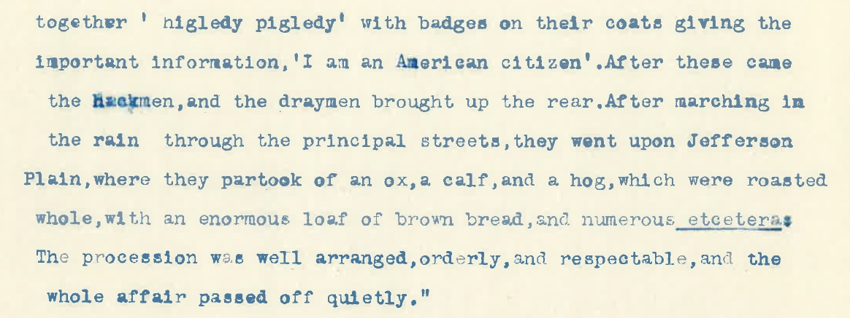
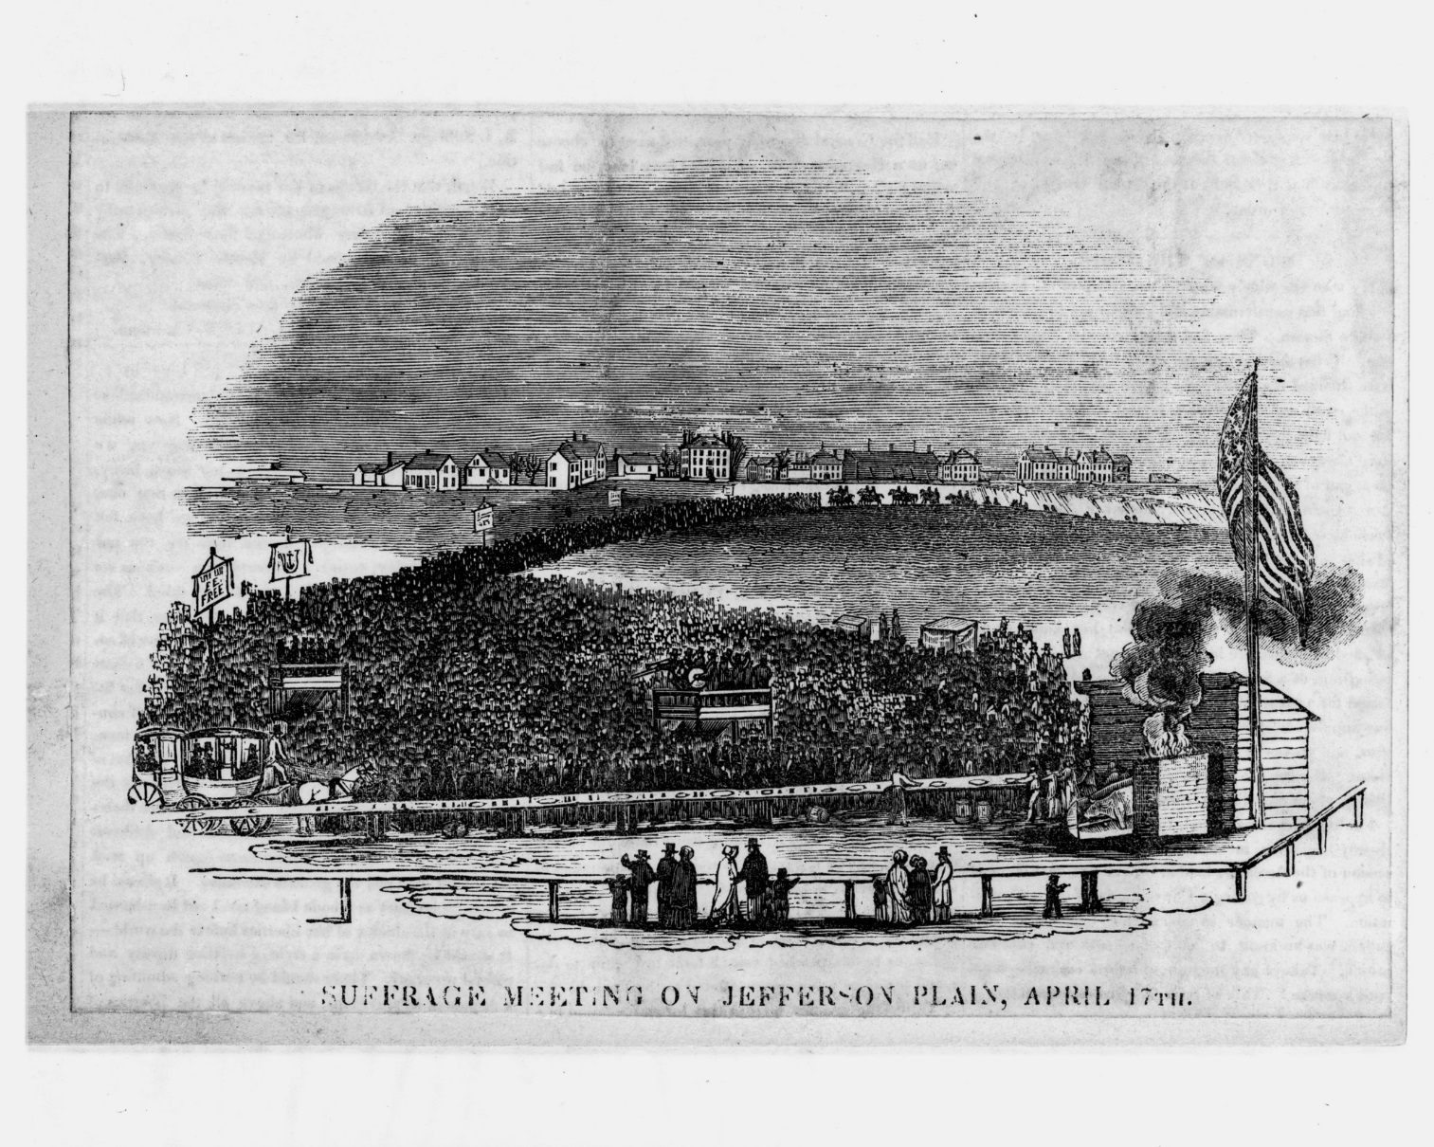
Excerpt from George Thurber’s Diary

Slide 14
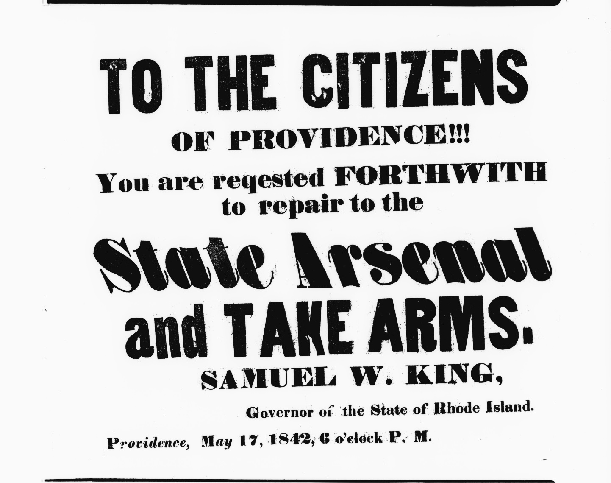

Slide 15
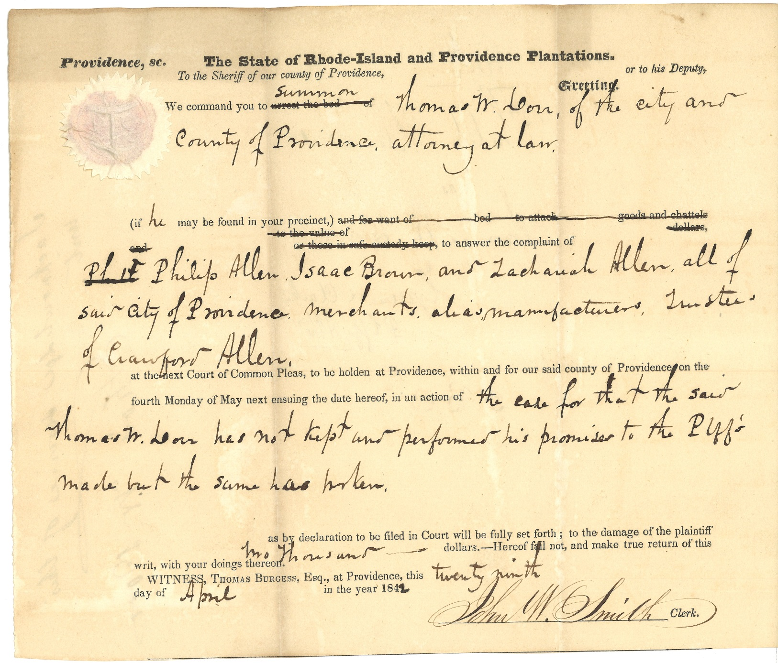

Slide 17
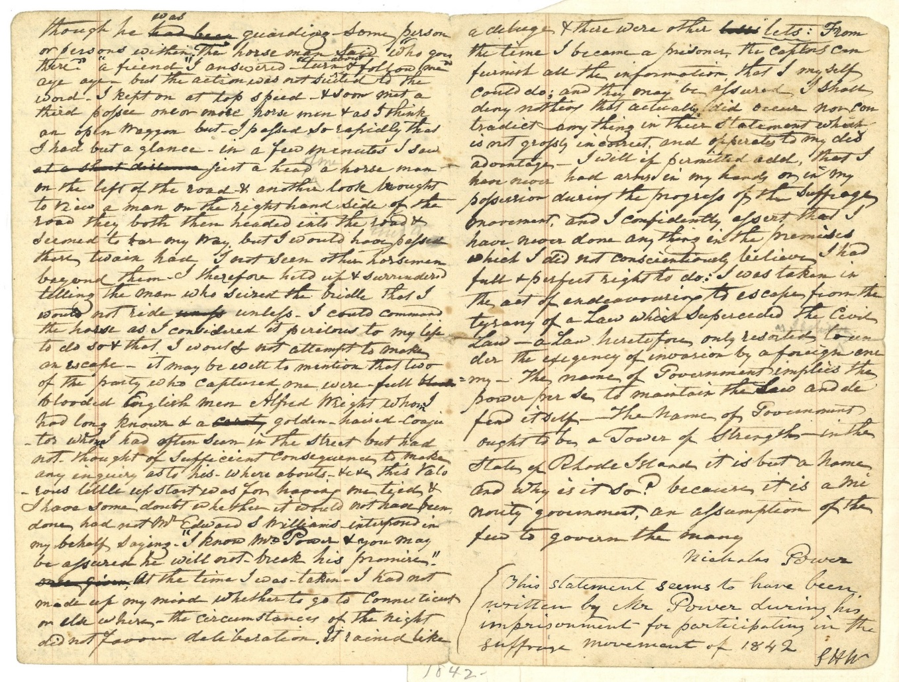
MSS 631 Nicholas Power Personal Account

Slide 18
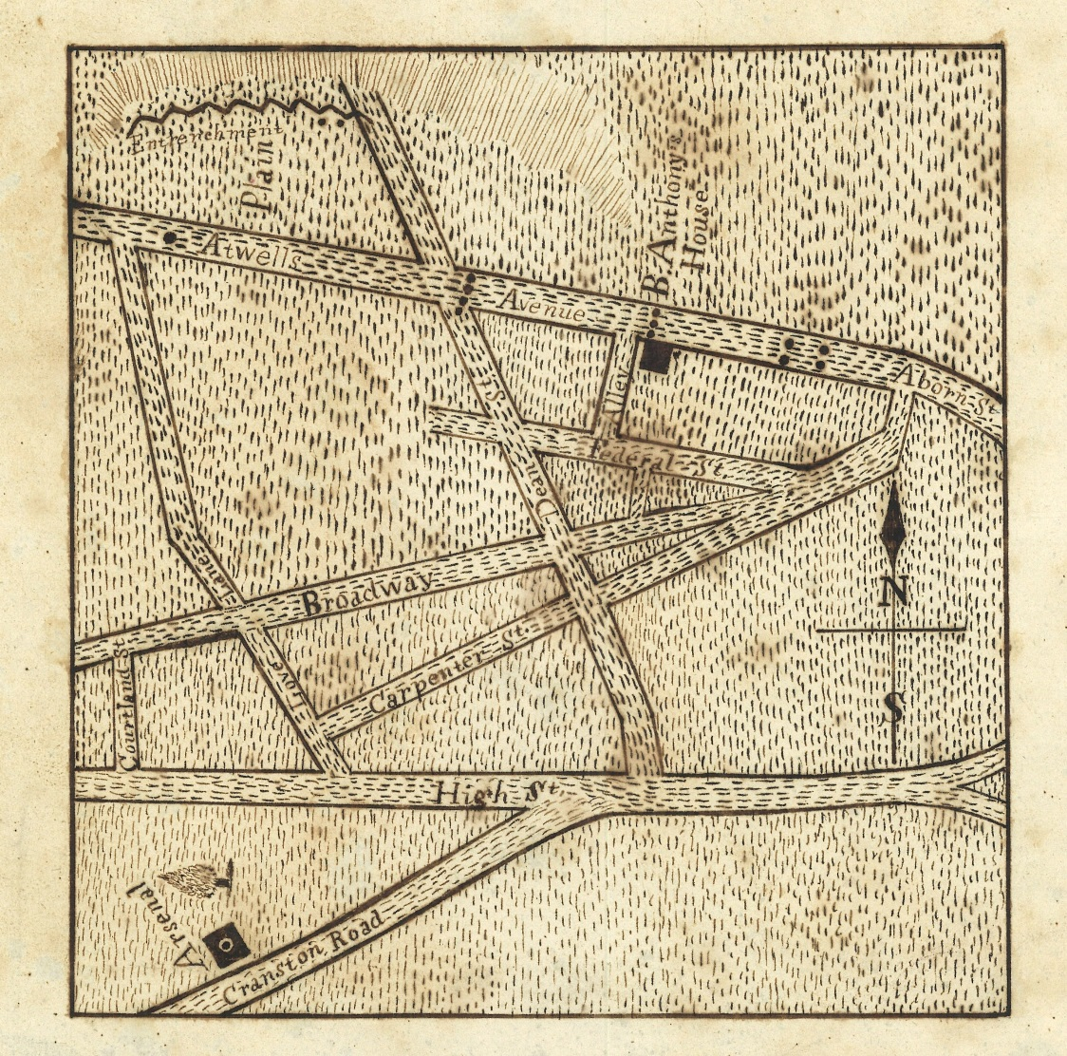
Map # 2729

Slide 19
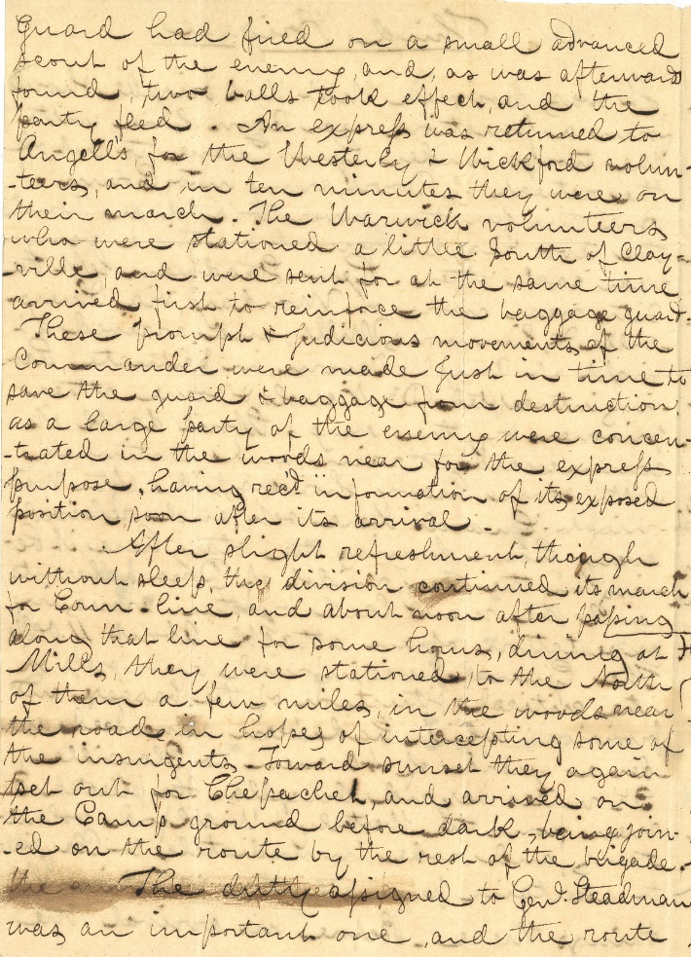
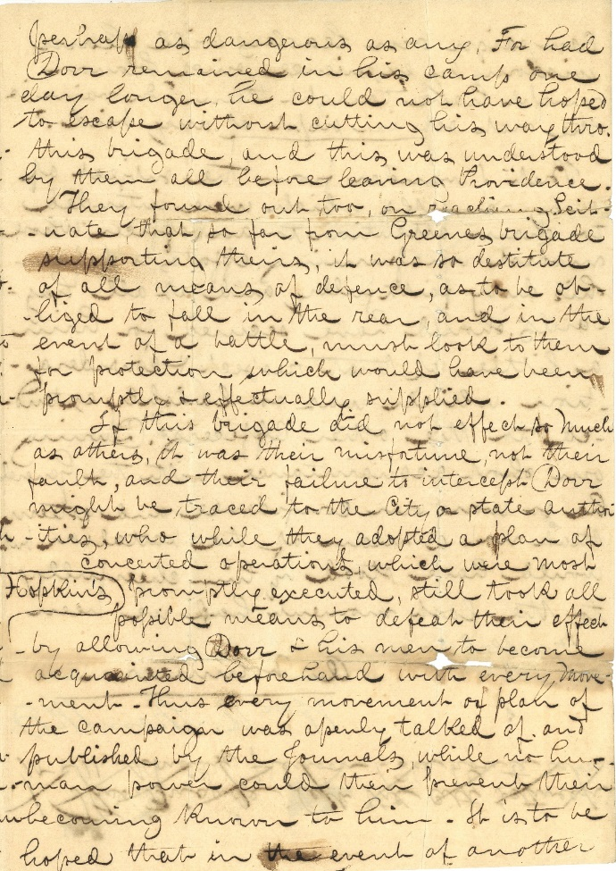
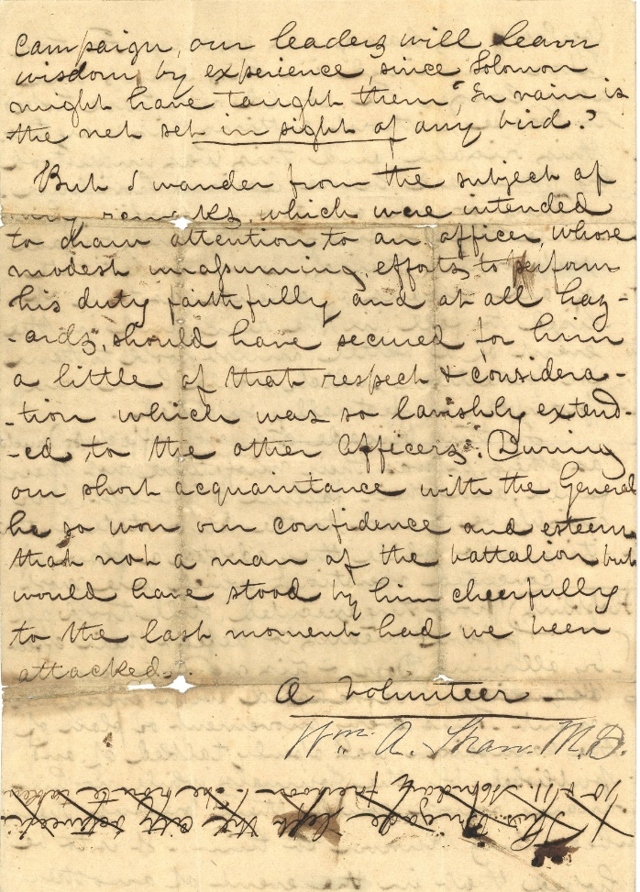
MSS 673 sg7 Description of the Movements of the 3rd Brigade [William A. Shaw M.D.]

Slide 20
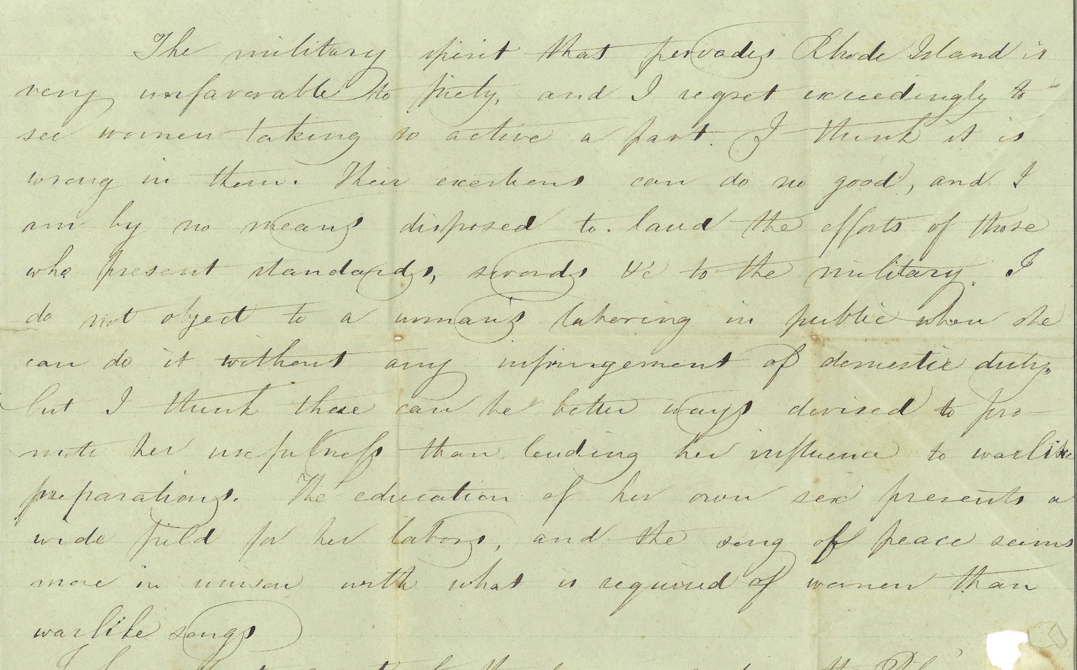
MSS 1033 Letter to Emily Winsor from Sarah Pratt 9 Oct 1842

Slide 21
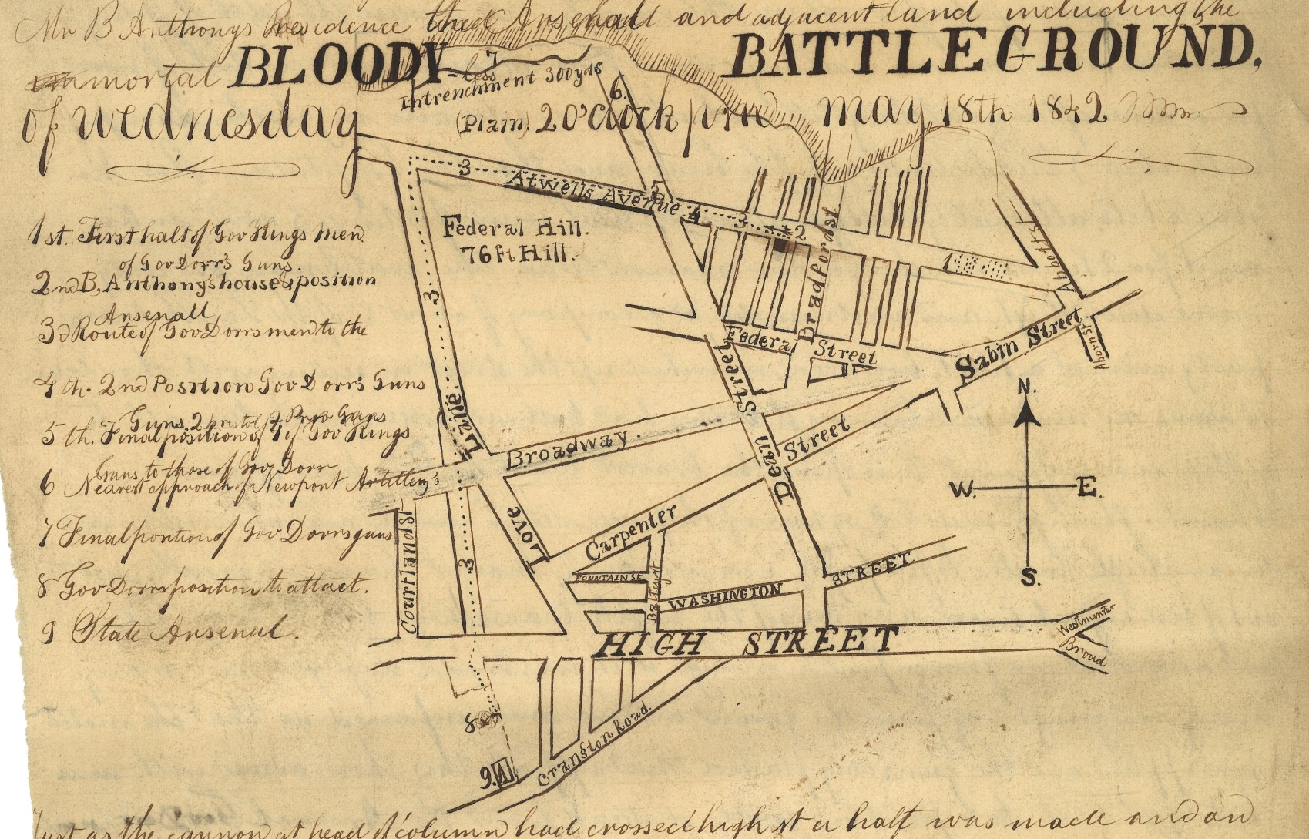
MSS 9001-D Unsigned Narrative

Slide 22
After…

Slide 23
MSS 452 Charges Against Thomas W. Dorr August 1842

Slide 24
MSS 483 sg 13 Joseph Peace Hazard Memorandum

Slide 26
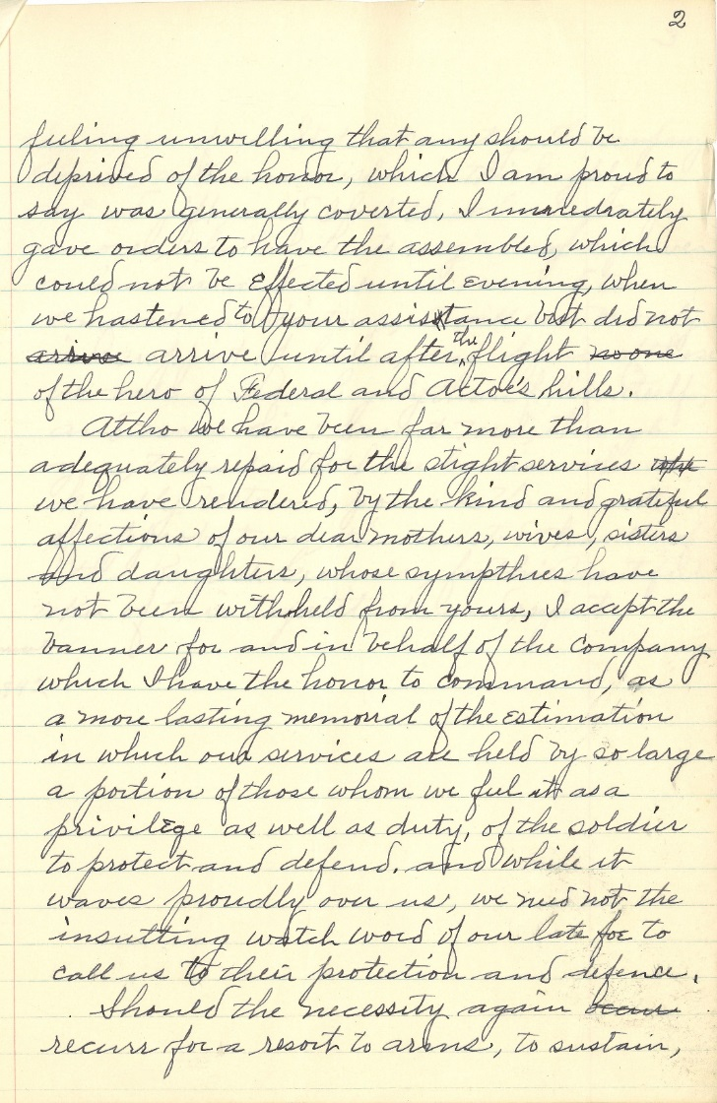
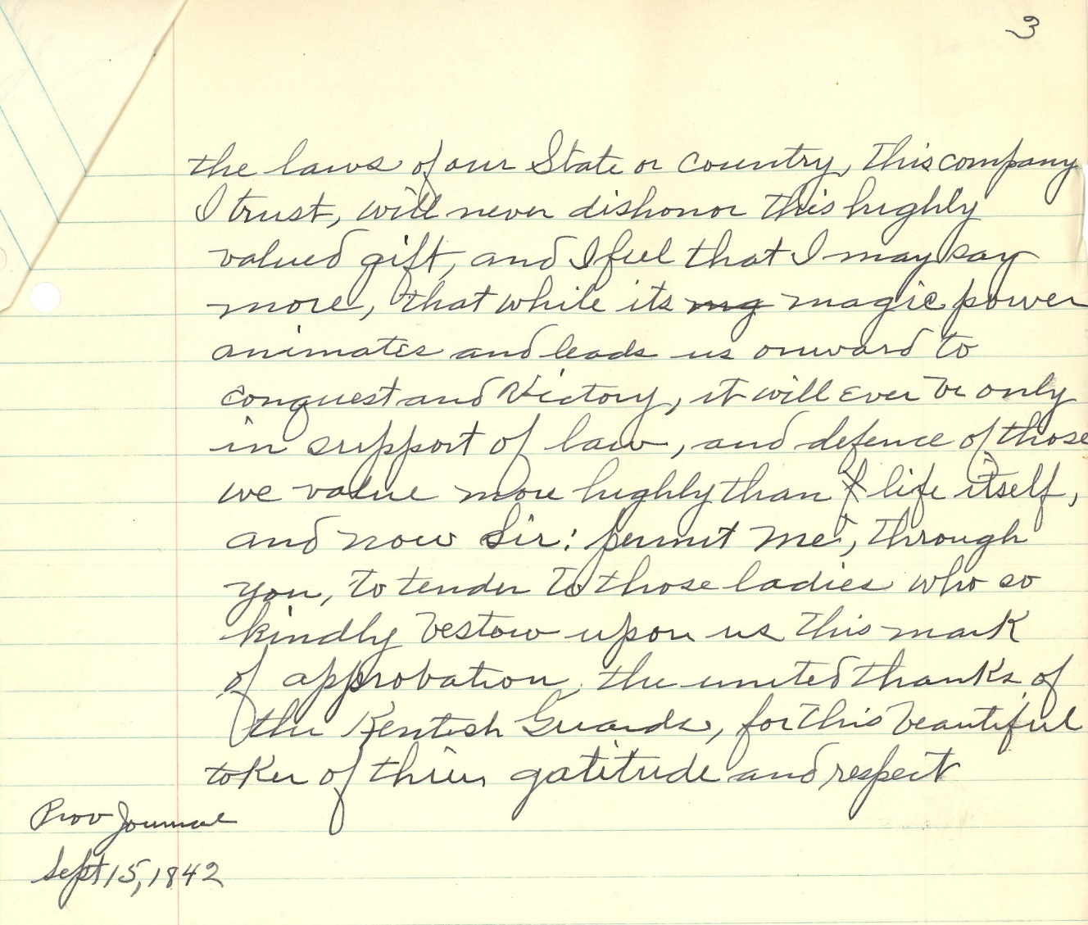
MSS 9001-A Narrative of Col. Thomas Allen

Slide 27
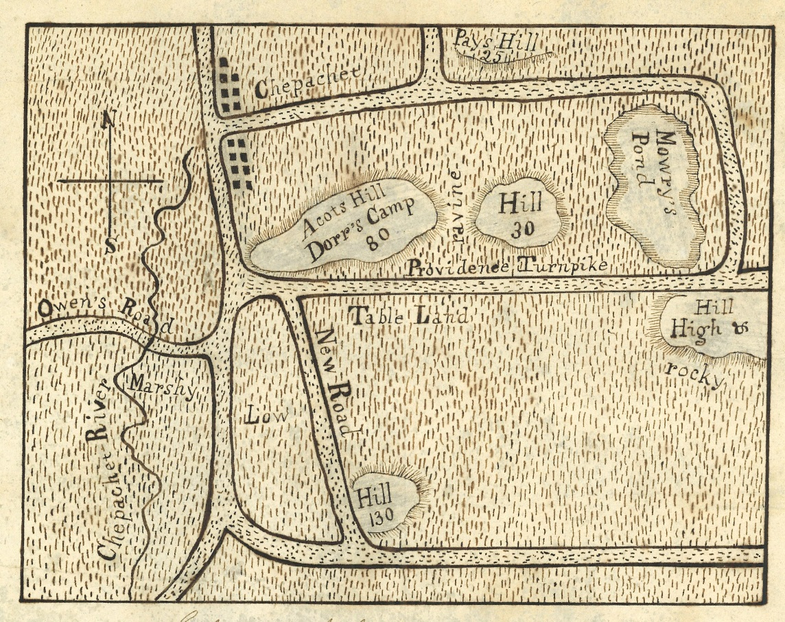
Map # 2730

Slide 28
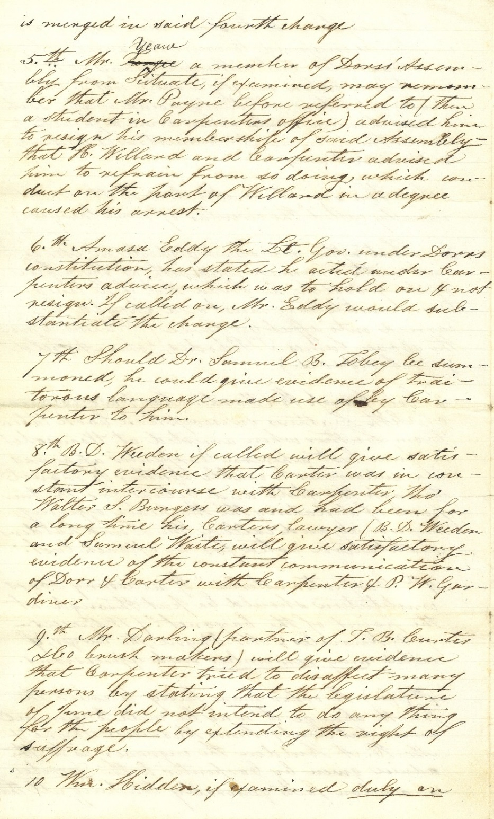
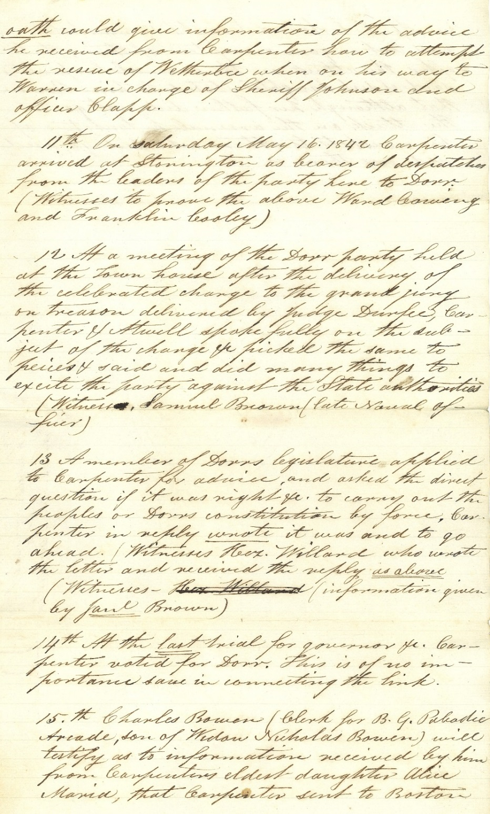
MSS 977 Defense of Thomas Carpenter Who Was Arrested During the Rebellion

Slide 30
MSS 9001-S Personal Account of [J.B. Sessions] 27 June 1844

Slide 31
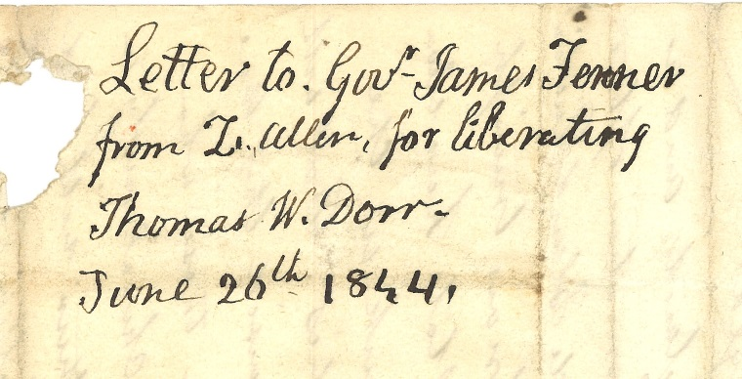
MSS 254

Slide 33
SECONDARY SOURCES
SECONDARY SOURCES INVOLVE ANALYSIS, SYNTHESIS, INTERPRETATION, OR EVALUATION OF PRIMARY SOURCES. THEY OFTEN ATTEMPT TO DESCRIBE OR EXPLAIN PRIMARY SOURCES.

Slide 34
Some Resources Can Provide Both
PRIMARY & SECONDARY SOURCES

Slide 35
The Broadsides of the Dorr Rebellion

Slide 36
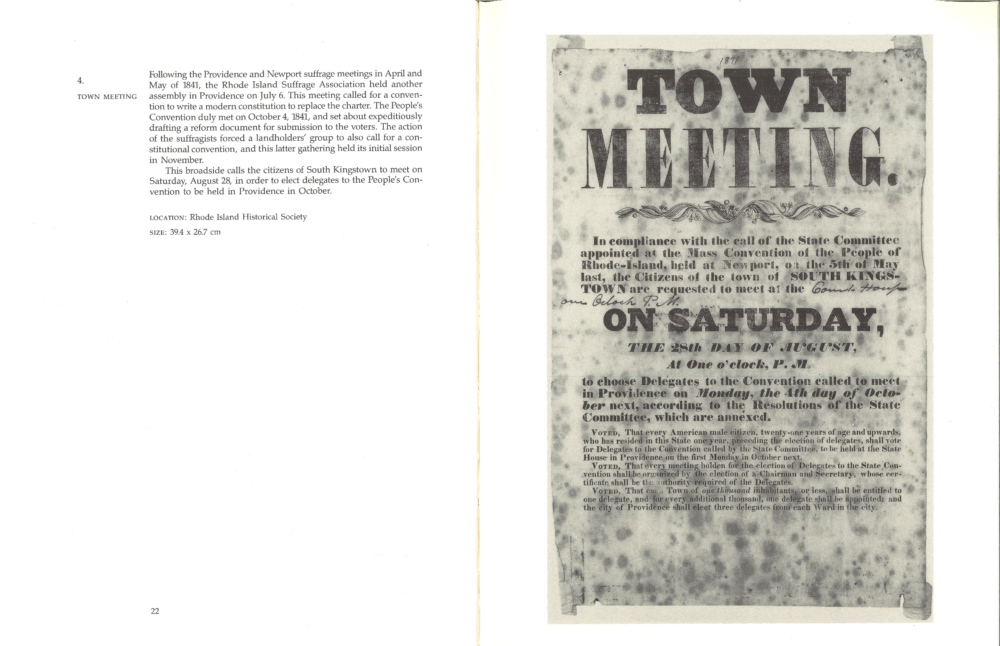

Slide 37
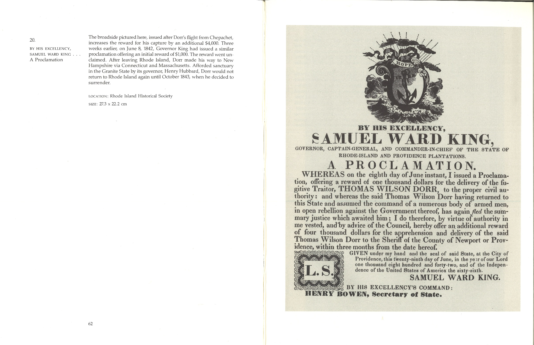

Slide 38
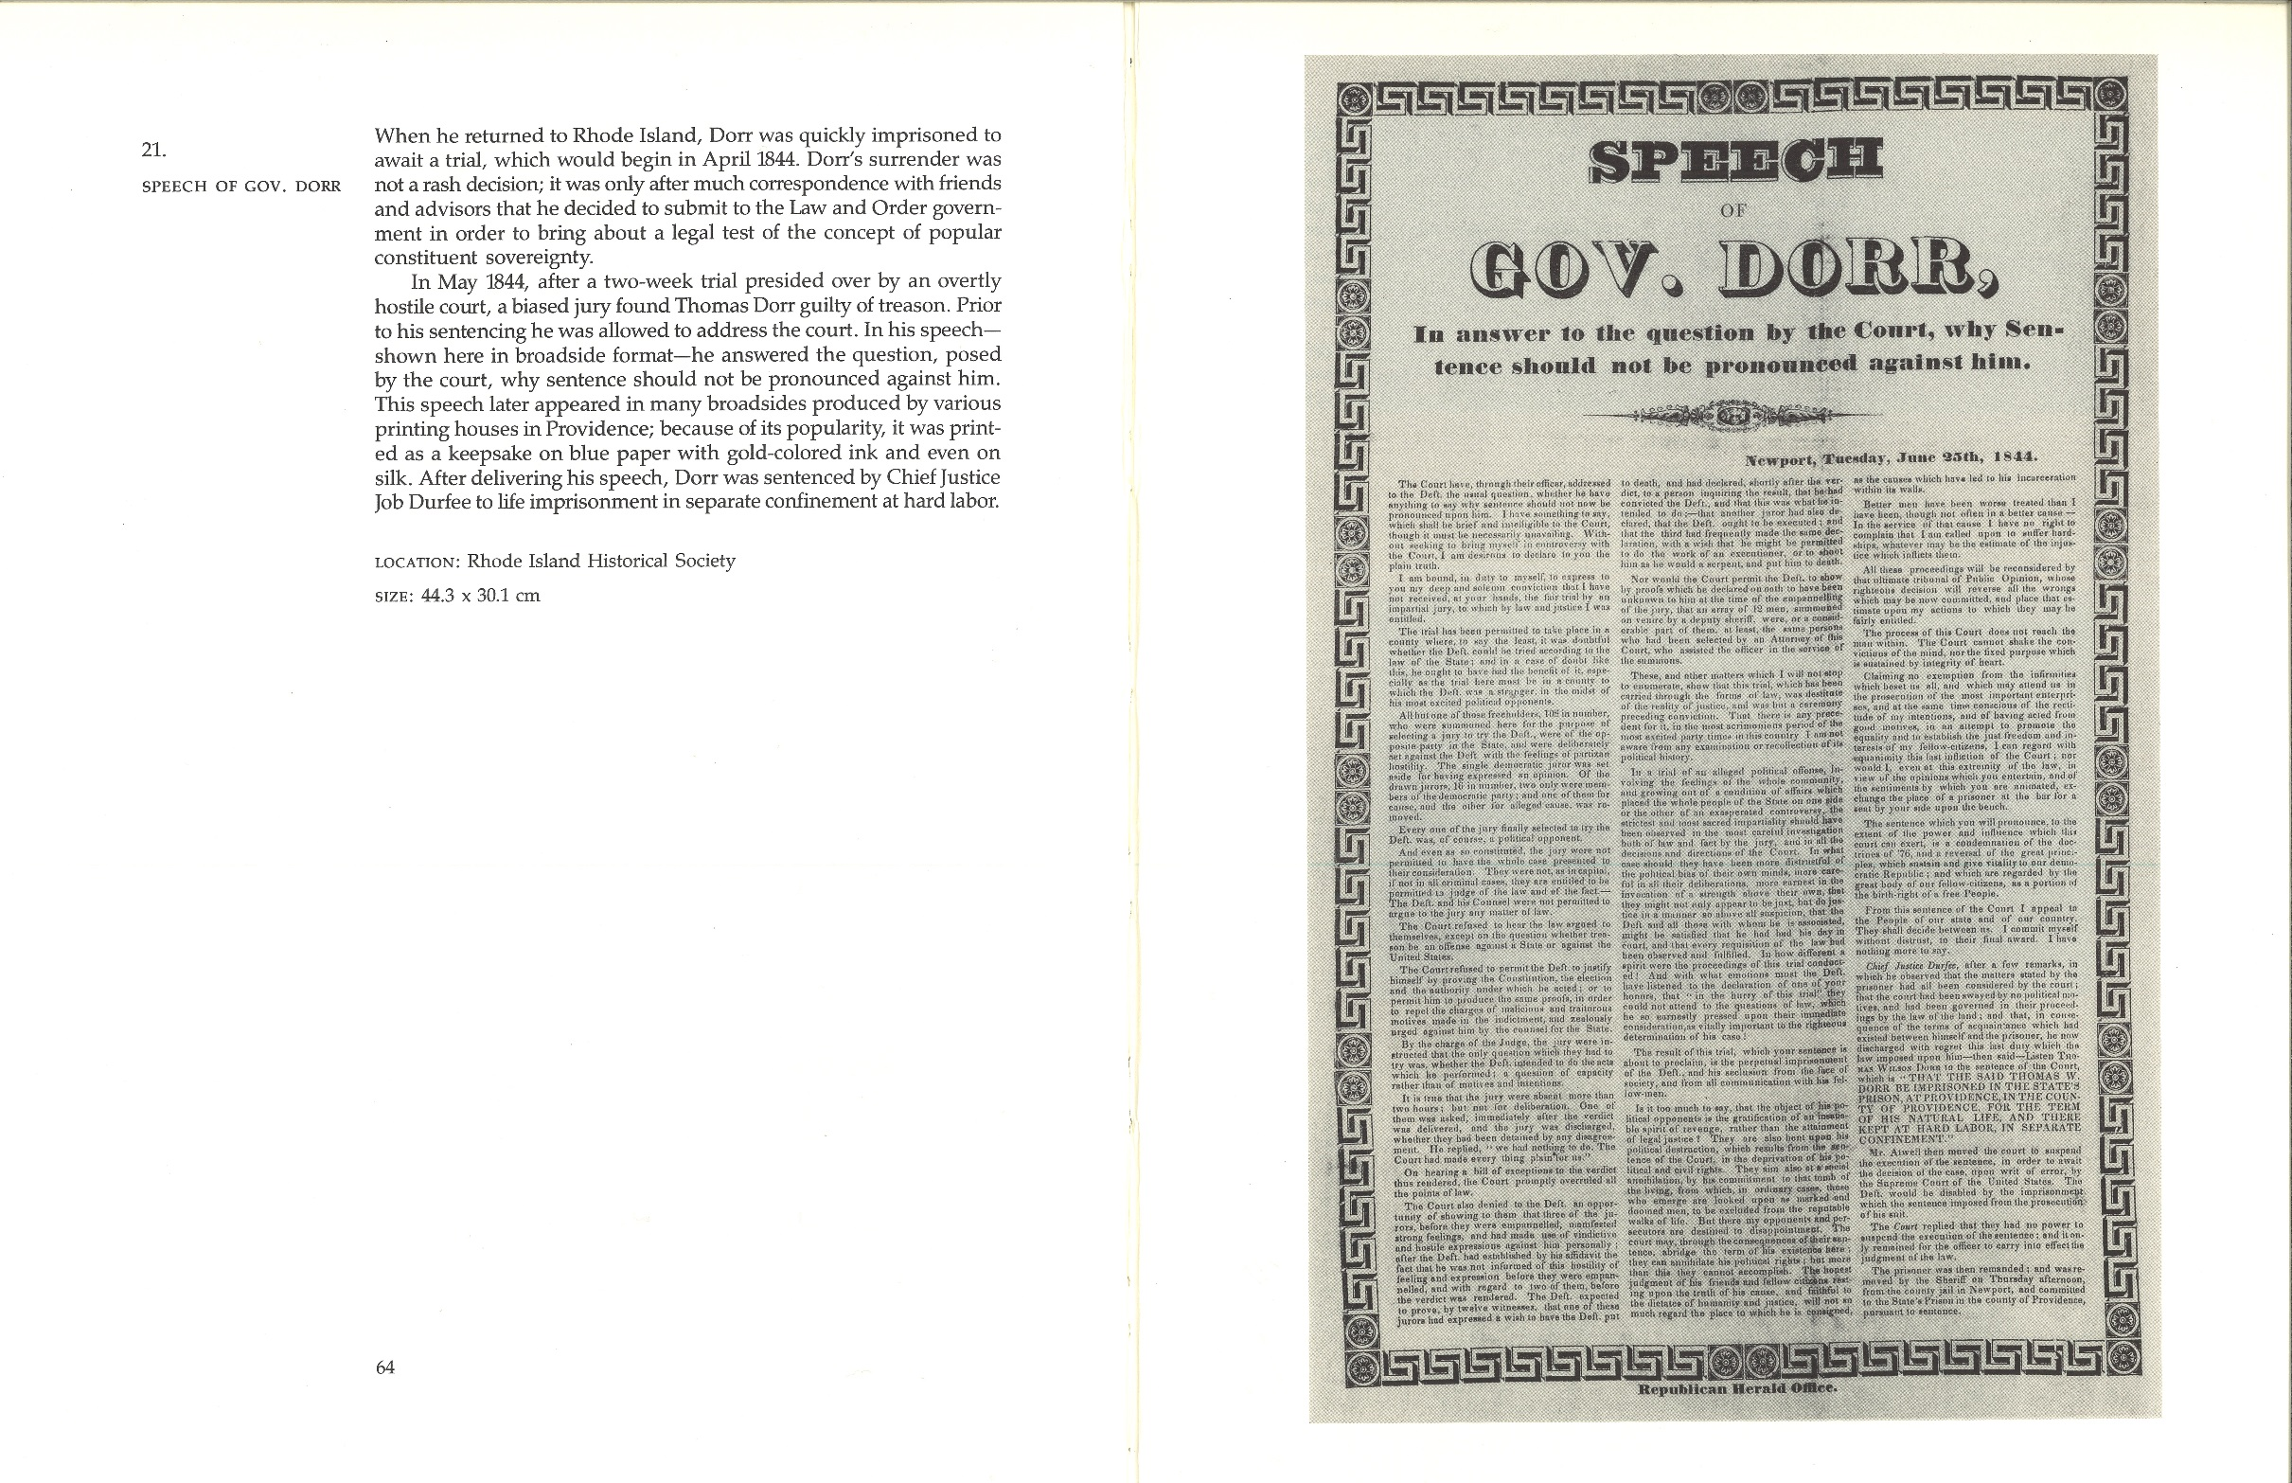

Slide 39
Scholarly Articles from RI History

Slide 40
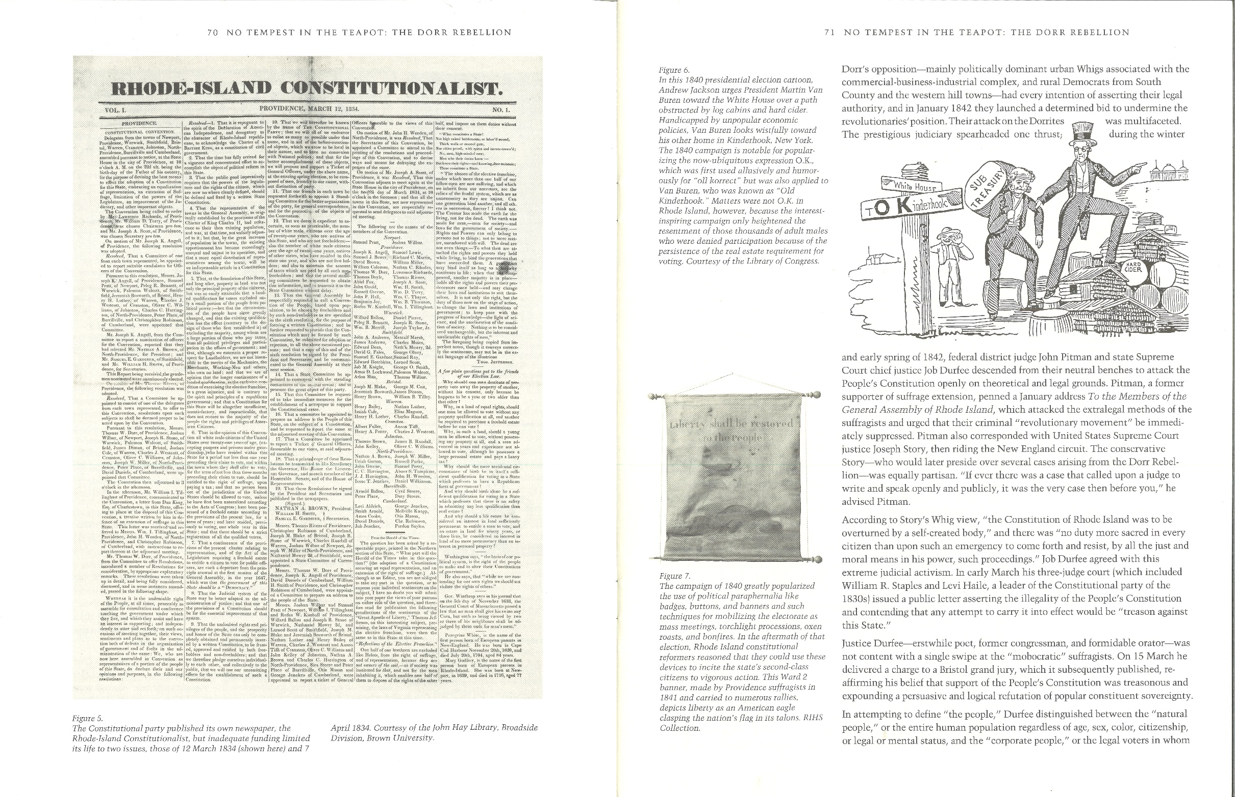

Slide 41
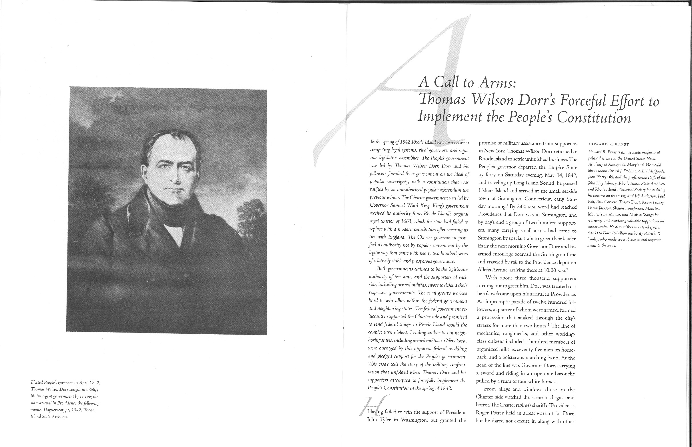

Slide 42
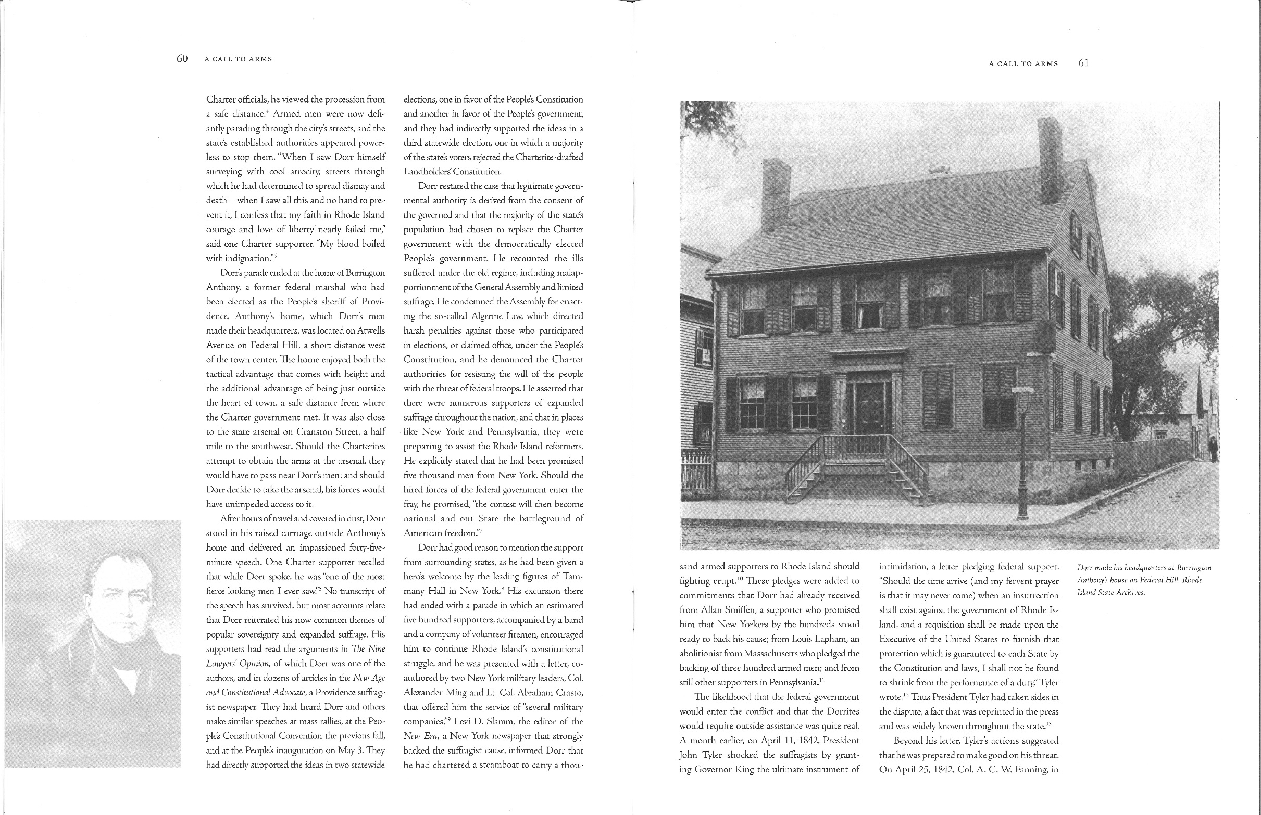

Slide 43
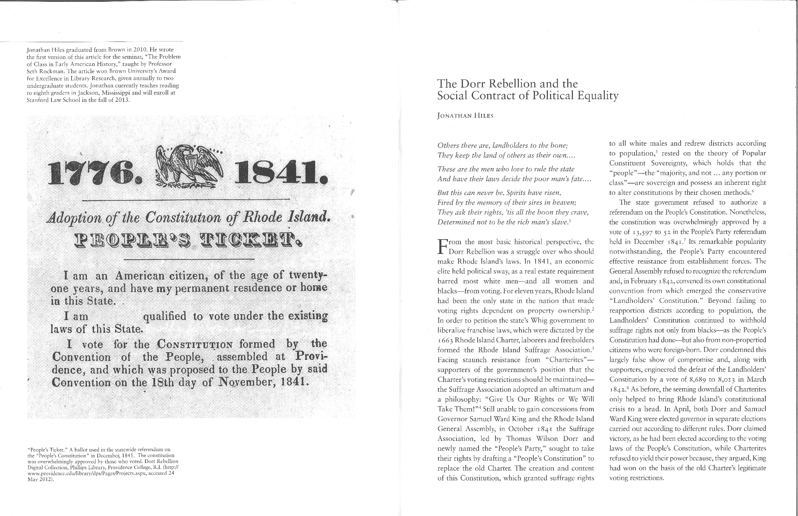

Slide 44
Footnotes & End Notes

Slide 45
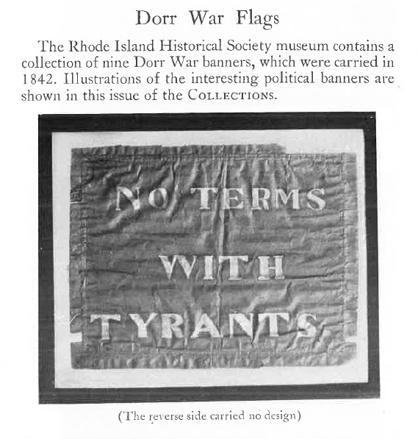
Typical Secondary Sources

Slide 46
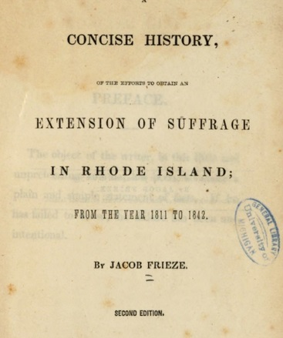
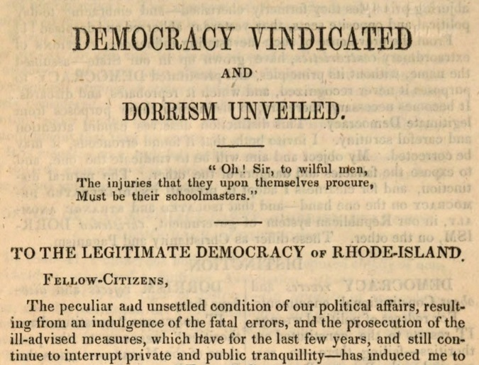

Slide 47
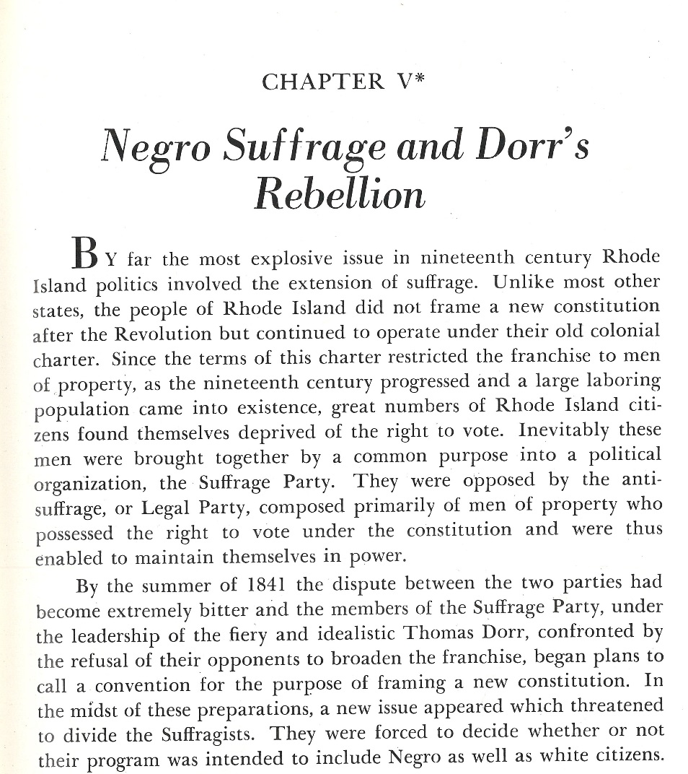
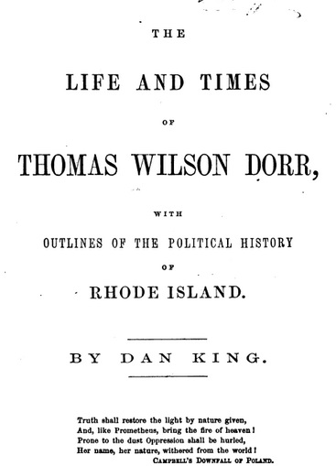
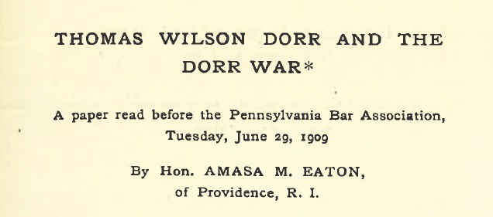

Slide 48
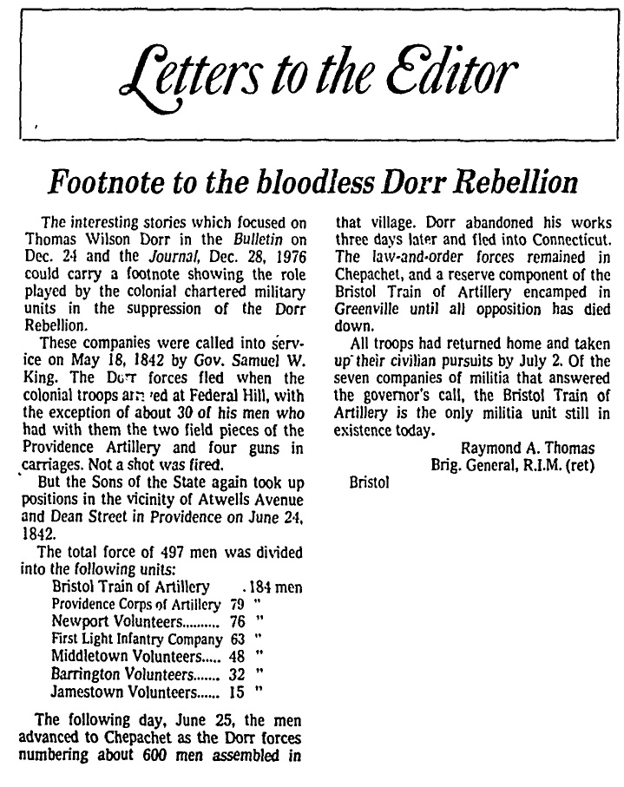
Newspaper Accounts & Retellings

Slide 49
